Slide 1


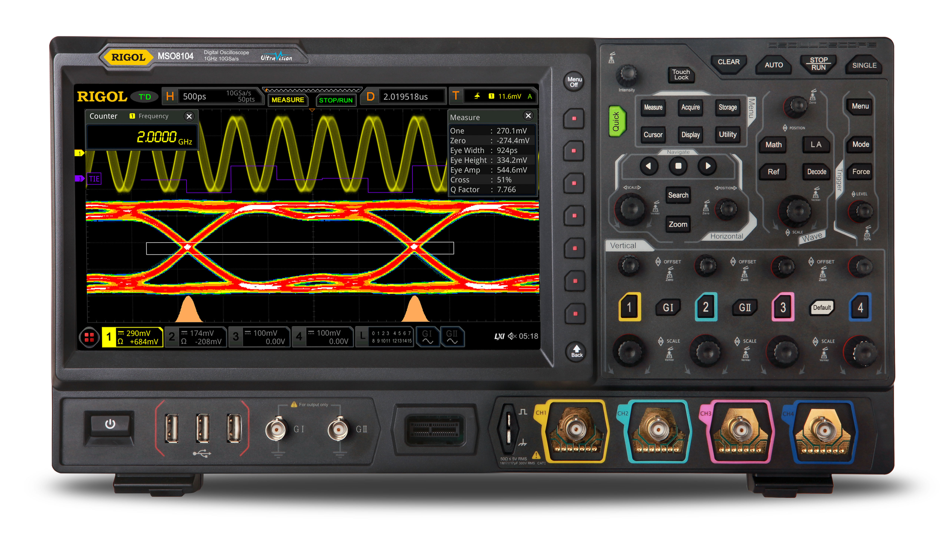
DBSP: Incremental Computation on Streams and Its Applications to Databases
Mihai Budiu – .
May 12, 2026
Carnegie Mellon University
SQL or Death? DB Seminar Series

Slide 2
What is this talk about?
DSP = Digital Signal Processing (stream computations)
DB = Databases
DBSP = Databases as Stream Processors
A language for computing on streams (dataflow graphs)
4 operators (2 discussed today)
Turing-complete
Define incremental computation in DBSP
Algorithm to convert any DBSP computation to an incremental form
DB queries expressed in DBSP
DB IVM = DBSP incremental computation

Slide 3


Resources
Best paper award
DBSP: Automatic Incremental View Maintenance for Rich Query Languages Mihai Budiu, Tej Chajed, Frank McSherry, Leonid Ryzhyk, Val Tannen
DBSP: Incremental Computation on Streams and Its Applications to Databases
We have built all of this, and it works!
github.com/feldera/feldera
ACM SIGMOD 2024 Research
Highlights
Award

Slide 4
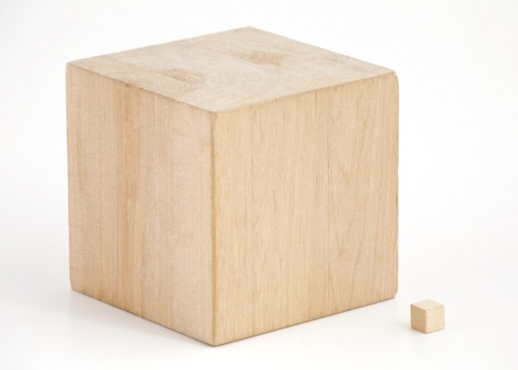
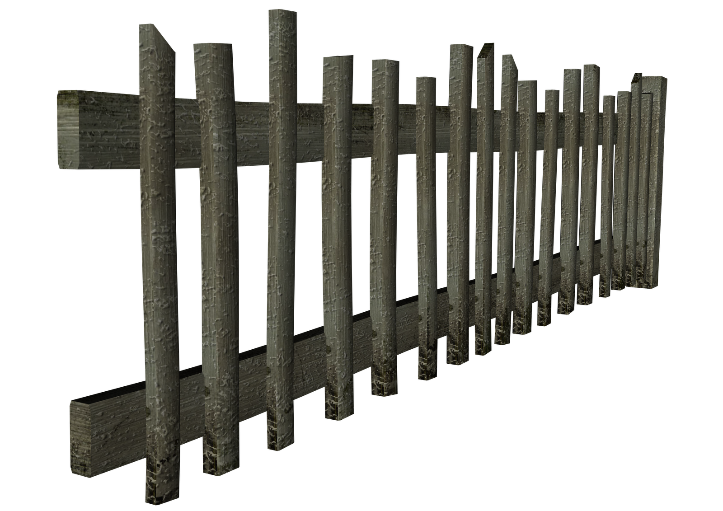
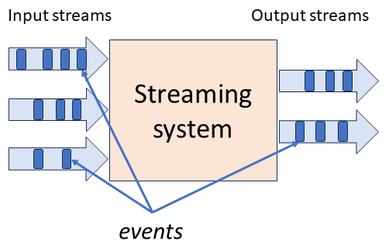
stream
DB
IVM
IVM
Database

Slide 5



Setup: A database and a query
$$Q$$

Slide 6

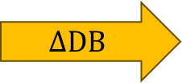

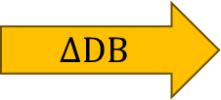



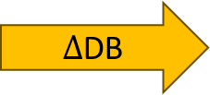

Periodic query evaluation
CREATE VIEW V AS SELECT … FROM …
V
V
V
V
V
$$Q$$
$$Q$$
$$Q$$
$$Q$$
$$Q$$
$Δ$DB
$$ΔDB$$
$$ΔDB$$
$$ΔDB$$
$$ΔDB$$
~100 rows
~1B rows
Time
transactions

Slide 7

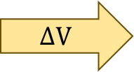


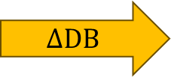


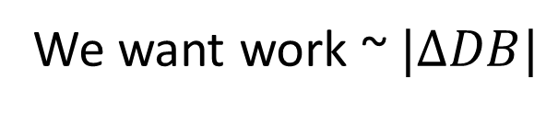



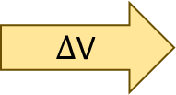
Incremental View Maintenance
We want work ~$|ΔDB|$
V
V
V
V
V
$$ΔV$$
$$ΔV$$
$$ΔV$$
$$ΔV$$
$Δ$V
$$Q$$
$$Q^{Δ}$$
$$Q^{Δ}$$
$$Q^{Δ}$$
$$Q^{Δ}$$
$$Q^{Δ}$$
$$ΔDB$$
$$ΔDB$$
$$ΔDB$$
$$ΔDB$$
$$ΔDB$$
Time

Slide 8
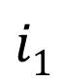

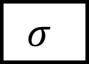
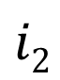
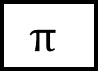

Dataflow graphs (query plans)
Boxes = computations
Arrows = values
$$Q$$
$$i1$$
$$σ$$
$$⋈$$
o
$$i2$$
$$π$$

Slide 9

Outline
Incremental View Maintenance
Stream computations
Databases as streaming systems
Incremental computation on streams
Deltas for relations
SQL in DBSP
Implementation

Slide 10

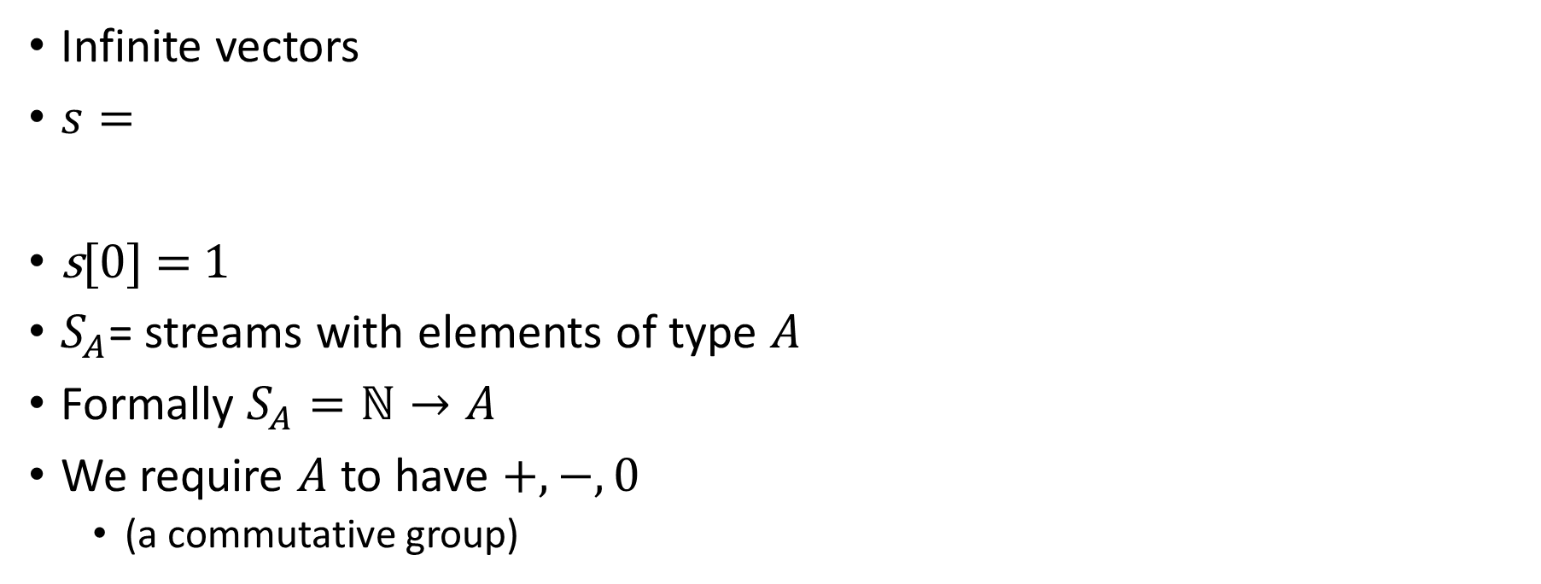
Streams
Infinite vectors
$s=$
s[0] = 1
$S_{A}$= streams with elements of type $A$
Formally $S_{A}=ℕ→A$
We require $A$ to have $+, −, 0$
(a commutative group)
…
-1
-2
-1
0
1
2
1
time

Slide 11
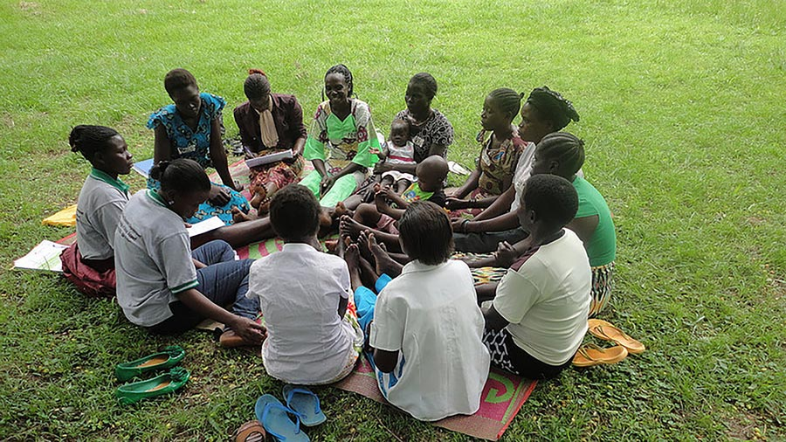
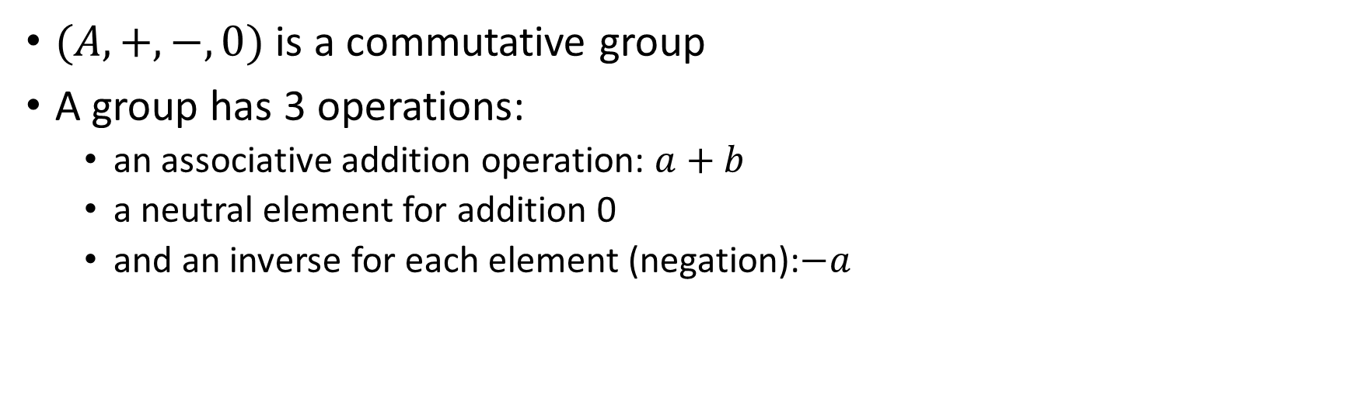
Groups
$(A, +, −, 0)$ is a commutative group
A group has 3 operations:
an associative addition operation: $a+b$
a neutral element for addition 0
and an inverse for each element (negation):$−a$

Slide 12
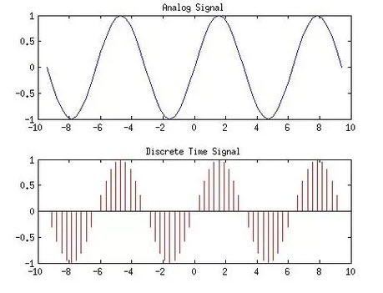
Analog and digital signals
Analog to digital conversion
Digital to analog conversion

Slide 13
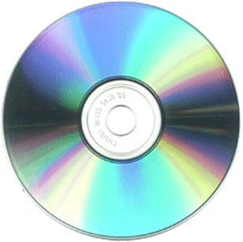
Nyquist–Shannon sampling theorem
If a signal contains no frequencies higher than B hertz, it is completely determined by giving its values at a series of points spaced 1/(2B) seconds apart.
Our ears cannot hear more than 20khz
CDs sampling rate is 44.1khz
Analog signal
Analog circuit
Analog signal
A/D
D/A
Digital signal
Program
Digital signal

Slide 14

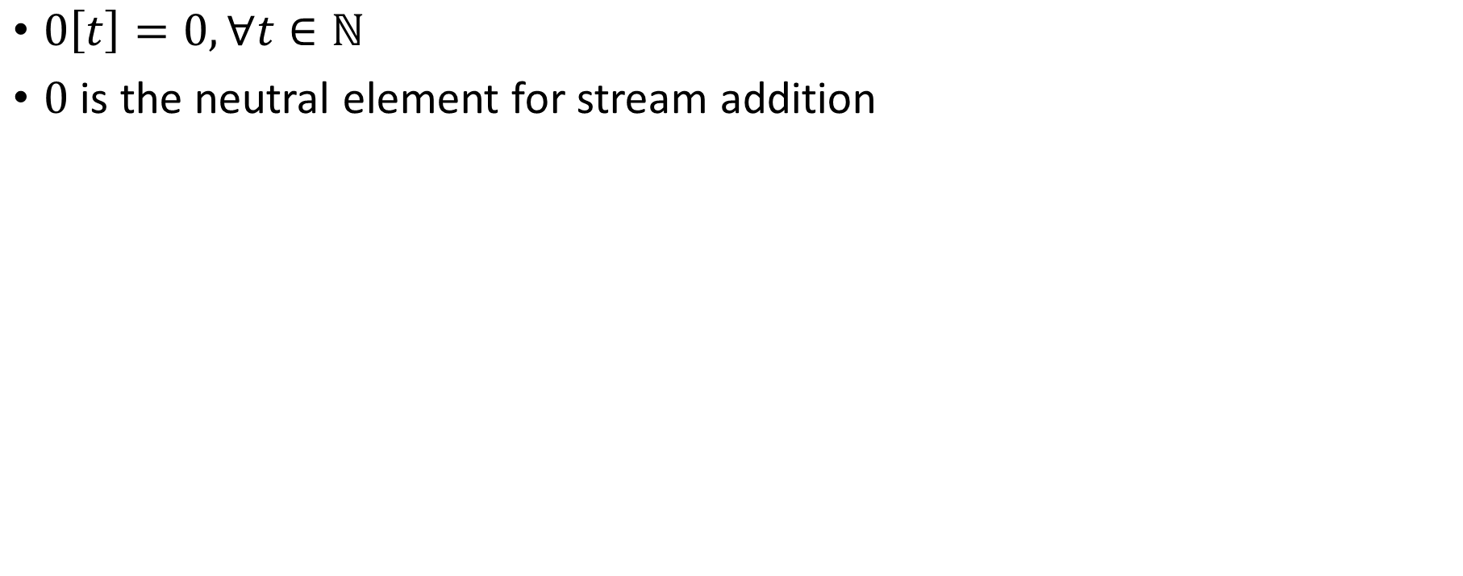
Silence
$0\left[t\right]=0, ∀t∈ℕ$
$0$ is the neutral element for stream addition

Slide 15
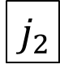
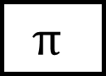
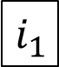
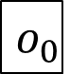

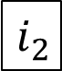
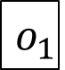
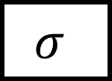
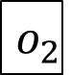
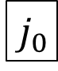
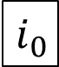
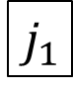
Stream computations
Inputs and outputs are streams
double arrows
…
$$i_{2}$$
$$i_{1}$$
$$i_{0}$$
$$σ$$
$$⋈$$
…
$$o_{2}$$
$$o_{1}$$
$$o_{0}$$
…
$$j_{2}$$
$$j_{1}$$
$$j_{0}$$
$$π$$

Slide 16
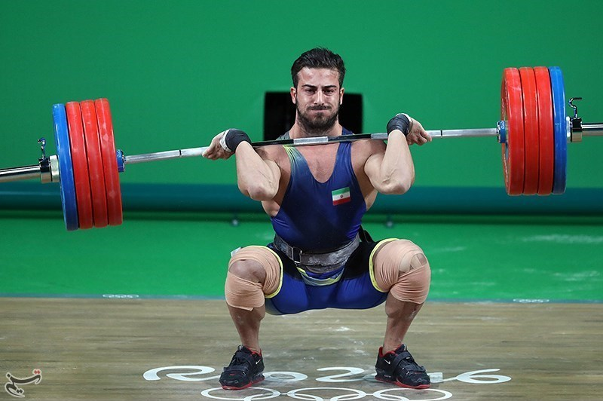
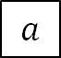
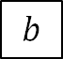
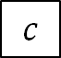
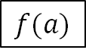
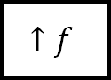
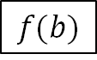
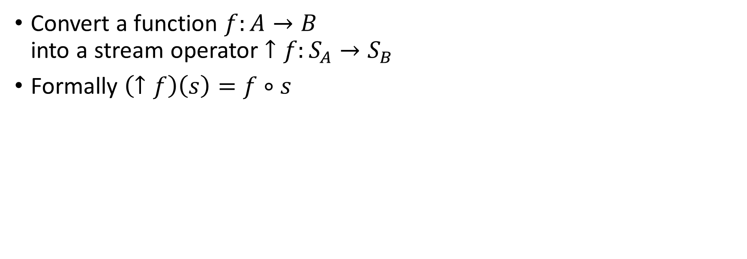
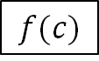
Lifting (DBSP operator #1)
Convert a function $f:A→B$ into a stream operator $↑f:S_{A}→S_{B}$
Formally $\left(↑f\right)\left(s\right)=f∘s$
…
$$c$$
$$b$$
$$a$$
$$↑f$$
…
$$f(c)$$
$$f(b)$$
$$f(a)$$

Slide 17
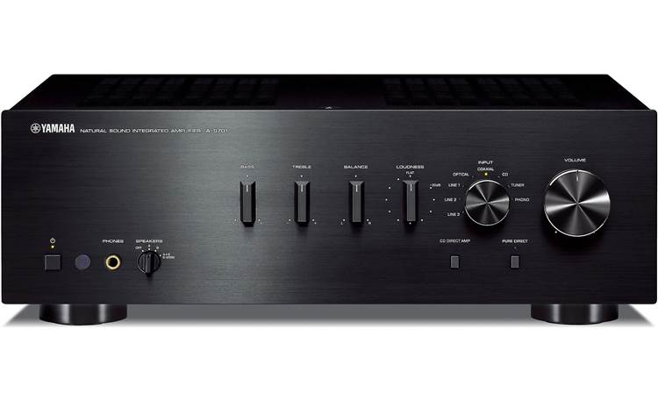
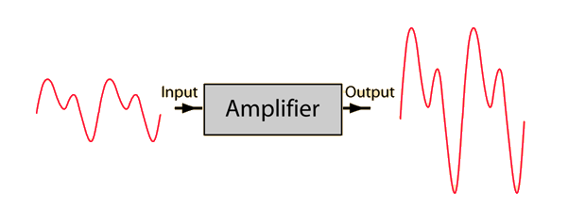
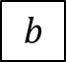
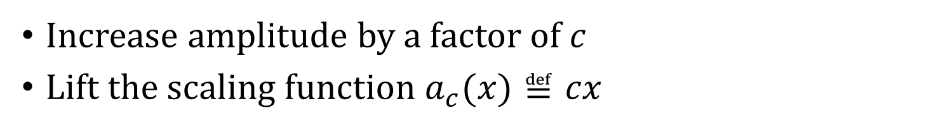
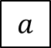
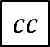
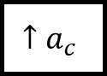
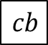
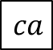

Amplification
Increase amplitude by a factor of $c$
Lift the scaling function $a_{c}(x)≝cx$
$$a$$
$$b$$
$$c$$
…
$$↑a_{c}$$
$$ca$$
$$cb$$
$$cc$$
…

Slide 18









Negation
Lifted unary minus
$−:S_{ℝ}→S_{ℝ}$
$\left(− s\right)\left[t\right]=−(s\left[t\right])$
$$a$$
$$b$$
$$c$$
…
$$−$$
$$−a$$
$$−b$$
$$−c$$
…

Slide 19

Noise cancellation
Predict future values (easy for periodic signals)
Generate a negated stream
Add it to original stream
i
+
o
-

Slide 20


Delay ($z^{−1}$ ) (DBSP operator #1)
Output is input stream delayed by one step
First value is 0
Stores internal state (the only operator with state)

Slide 21









Computing changes (deltas) Differentiation
$$o\left[t\right]=s\left[t\right]–s\left[t−1\right]$$
$$D$$
$$o$$
o is the stream of changes of s
…
$$2$$
$$3$$
$$2$$
1
$$D$$
…
$$−1$$
$$1$$
$$1$$
1
stream of deltas

Slide 22









Integration
$$I$$
$o[0] =s[0]$
$o[t] =s[t] + o[t−1]$
$o\left[t\right]=s\left[0\right]+s\left[1\right]+ …+s[t]$
$$s$$
$$o$$
If s is a stream of changes…
… then o is the original stream
…
$$−1$$
$$1$$
$$1$$
1
$$I$$
…
$$2$$
$$3$$
$$2$$
1
stream of deltas

Slide 23

$D$ and $I$ “cancel out”

Slide 24





DB+= $Δ$
$$Δ[2]$$
$$Δ[1]$$
$$Δ[0]$$
Stream of experiences

Slide 25
Outline
Incremental View Maintenance
Stream computations
Databases as streaming systems
Incremental computation on streams
Deltas for relations
SQL in DBSP
Implementation

Slide 26










All databases are streaming databases!
Consider a database $DB$, a set of tables
A committed transaction is a change to $DB$
The set of linearized transactions define $T,$ a stream of changes to $DB$
$T[k]$is the $k$-th transaction
$DB$ is a stream of database snapshots
$DB[k]$ is the contents of the database after $k$ transactions have been committed
$DB[k] = I(T)[k$]
A database (stream) is the integral of a transaction stream
…
$$T_{3}$$
$$T_{2}$$
$$T_{1}$$
$$T_{0}$$
$$I$$
…
$${DB}_{3}$$
$${DB}_{2}$$
$${DB}_{1}$$
$${DB}_{0}$$

Slide 27














Views are lifted queries
Let $Q$ be a query defining a view $V$
$V[k]=Q\left(DB[k]\right)$
$V$ is a stream of view snapshots:
$$V= ↑Q(DB)$$
$$↑Q$$
$$…$$
$$V_{3}$$
$$V_{2}$$
$$V_{1}$$
$$V_{0}$$
Versions of $V$
Versions of $DB$
$$…$$
$${DB}_{3}$$
$${DB}_{2}$$
$${DB}_{1}$$
$${DB}_{0}$$

Slide 28
Remember this picture?
V
V
V
V
V
$$ΔV$$
$$ΔV$$
$$ΔV$$
$$ΔV$$
$Δ$V
$$Q$$
$$Q^{Δ}$$
$$Q^{Δ}$$
$$Q^{Δ}$$
$$Q^{Δ}$$
$$Q^{Δ}$$
$$ΔDB$$
$$ΔDB$$
$$ΔDB$$
$$ΔDB$$
$$ΔDB$$
Time

Slide 29








Some interesting streams
Stream of database
snapshots
DB[0]
DB[1]
DB[2]
DB[3]
$$ΔDB[0]$$
$$ΔDB[1]$$
$$ΔDB[2]$$
$$ΔDB[3]$$
… transactions
V[0]
V[1]
V[2]
V[3]
… view
snapshots
$ΔV$[0]
$ΔV$[1]
$$ΔV[2]$$
$$ΔV[3]$$
… view
changes

Slide 30
Outline
Incremental View Maintenance
Stream computations
Databases as streaming systems
Incremental (DB) computations
Deltas for relations
SQL in DBSP
Implementation

Slide 31

















Incremental view maintenance of view $V$
$${(↑Q)}^{Δ}$$
$$…$$
$$T_{2}$$
$$T_{1}$$
$$T_{0}$$
$$I$$
$$↑Q$$
D
$$…$$
$$ΔV_{2}$$
$$ΔV_{1}$$
$$ΔV_{0}$$
Changes to $DB$
Changes to $V$
$$…$$
$$V_{2}$$
$$V_{1}$$
$$V_{0}$$
Versions of $V$
Versions of $DB$
$$…$$
$${DB}_{2}$$
$${DB}_{1}$$
$${DB}_{0}$$

Slide 32











Incremental view maintenance
This is our definition of IVM
This definition is much better:
Well-defined for any Q
does not need to compute dQ/di
It is compositional
Inputs and outputs are both deltas
It works, but is inefficient
$${(↑Q)}^{Δ}$$
$$…$$
$$T_{2}$$
$$T_{1}$$
$$T_{0}$$
$$I$$
$$↑Q$$
D
$$…$$
$$ΔV_{2}$$
$$ΔV_{1}$$
$$ΔV_{0}$$
Changes to $DB$
Changes to $V$
…
$$V_{2}$$
$$V_{1}$$
$$V_{0}$$
Versions of $V$
$$…$$
$${DB}_{2}$$
$${DB}_{1}$$
$${DB}_{0}$$
Versions of $DB$

Slide 33










Incremental queries are streaming systems
$${Δi}_{0}$$
$${Δi}_{1}$$
$${Δi}_{2}$$
$${Δi}_{3}$$
…
$$Q^{Δ}$$
$$Δo_{0}$$
$$Δo_{1}$$
$$Δo_{2}$$
$$Δo_{3}$$
…
state
$Q^{Δ}$ is a streaming system:
it runs forever
it maintains internal state (even if $Q$ is stateless)
the state is stored in the delay operators (inside $I$ and $D$)

Slide 34







Linear operators
$Q$ is linear if $Q(a+b) = Q(a) + Q(b)$
If $Q$ is linear: $Q=Q^{Δ}$
No state required!
Most relational queries use linear operators!
$${(↑Q)}^{Δ}$$
$$…$$
$$T_{2}$$
$$T_{1}$$
$$T_{0}$$
$$I$$
$$↑Q$$
D
$$…$$
$$ΔV_{2}$$
$$ΔV_{1}$$
$$ΔV_{0}$$

Slide 35








The chain rule
$$(Q_{2}{∘Q_{1})}^{Δ}=Q_{2}^{Δ}∘Q_{1}^{Δ}$$
Proof by pictures:
$$Q$$
$$Q_{1}$$
$$Q^{Δ}$$
$$Q_{1}^{Δ}$$
Compile
$$Q_{2}$$
$$Q_{2}^{Δ}$$

Slide 36

Bilinear operators
(Lifted) join, intersection, Cartesian product

Slide 37




Incremental Cartesian Product
$$a$$
$$a Δa$$
$$(a+Δa)×b$$
1
2
3
4
5
6
1
2
3
4
5
6
1
2
3
4
5
6
$$b$$
1
2
3
4
5
6
1
2
3
4
5
6
1
2
3
4
5
6
$Δ\left(a×b\right)=\left(a×Δb\right)+\left(Δa×b\right)+\left(Δa×Δb\right)$

Slide 38
Outline
Incremental View Maintenance
Stream computations
Databases as streaming systems
Incremental computation on streams
Deltas for relations
SQL in DBSP
Implementation

Slide 39


Hold on! This is not well-defined!
The definitions of $I$, $D$ require streams over a commutative group
However, tables (sets, multisets) are not groups
E.g., there is no table negation

Slide 40


$ℤ$-sets
Each row has an integer weight
The weight can be positive, zero, or negative
Formally $ℤ$-sets are functions $D→ℤ$ (with finite support)
Name | Age | Weight
Mike | 10 | 1
John | 12 | 3
Amy | 8 | -1
Chris | 10 | 2
tuples

Slide 41



$ℤ$-sets are magic!
Can represent both tables and changes to tables
Positive weights = elements added
Negative weights = elements removed
Generalize sets and multisets
Classic DB table = $ℤ$-set where all weights are 1
Form a commutative group (because $ℤ$ is a group)

Slide 42
Outline
Incremental View Maintenance
Stream computations
Databases as streaming systems
Incremental computation on streams
Deltas for relations
SQL in DBSP
Implementation

Slide 43



Relational algebra in $ℤ$-sets
Recursively defined on query structure
Many operations require a $distinct$
(But some can be removed)
The other operations are all linear or bilinear
Can also model
Group-by
Unnest
Aggregation
Recursion

Slide 44


Algorithm for incremental view maintenance
Translate recursively a DB query into a circuit $Q$ on $ℤ$-sets
Lift circuit to compute on streams: $↑Q$
Build incremental version of lifted circuit:
Optimize $Q^{Δ}$ using chain rule:
$$(Q{∘R)}^{Δ}=Q^{Δ}∘R^{Δ}$$
This algorithm is deterministic. There are no heuristics.

Slide 45

Example: (1) create circuit
CREATE VIEW V AS SELECT DISTINCT a.x, b.y FROM ( SELECT t1.x , t1.id FROM t1 WHERE t1.a > 2 ) a JOIN ( SELECT t2.id , t2.y FROM t2 WHERE t2.s > 5 ) b ON a.id = b.id
Inputs and outputs are collections, not streams

Slide 46


(2) Lift and (3) Incrementalize
(2)
Inputs and outputs are streams
(3)
Incrementalize:
Inputs and outputs are streams of changes

Slide 47



(4) optimize
Chain rule
Linearity
Expand join and distinct

Slide 48

Beyond relational algebra
GROUP BY
Aggregations
Window aggregates
TopK
Recursion
“Streaming” computations
Primary keys
We can incrementalize them all!

Slide 49

Mutually-recursive views
Two additional DBSP operators for fixpoints
Language becomes Turing-complete
~Datalog
Spreadsheet in SQL: https://xls.feldera.io/
Graph queries

Slide 50

Finite-memory computation on infinite streams
Streams = infinitely-growing tables
Syntax to specify limits to “out-of-order-ness” of data
Automatic garbage-collection of stale state
State that cannot influence any future outputs

Slide 51
Outline
Incremental View Maintenance
Stream computations
Databases as streaming systems
Incremental computation on streams
Deltas for relations
SQL in DBSP
Implementation

Slide 52

Formal verification
Theory was verified using the Lean theorem prover
https://github.com/tchajed/database-stream-processing-theory
First formally-specified and formally-verified theory of incremental view maintenance
We know exactly what we need to build

Slide 53

The start-up

Slide 54

DBSP Library
https://crates.io/crates/dbsp
MIT license
Rust framework to describe DBSP circuits
Support for relational algebra, nested relations, aggregates, etc.
Basic incremental and non-incremental operators (~80)
Multi-core execution

Slide 55
Interacting with the outside world
Kafka, DB (Debezium), http, csv, Delta lake, Google pub/sub, S3, JDBC, Snowflake, etc.
and any combination/any number of sources/destinations!
Rust
data
Z-sets
Z-sets
data
Data
source
input
adapter
DBSP
query engine
output
adapter
Data
sink
state

Slide 56




try.feldera.com
github.com/feldera/feldera
www.feldera.com/community

Slide 57


Three main ideas
System evolution modeled as streams (snapshots)
IVM: computation from changes to changes
$ℤ$-sets: model negative & positive changes

Slide 58
Extra slides

Slide 59
SQL compiler (MIT license)
SQL program
Calcite parser
Calcite planner
Calcite IR
DBSP IR
SQL compiler
user-
defined functions
SQL
runtime
library
DBSP optimizer
Rust codegen
Rust code
Rust compiler
exe
DBSP
library
I/O
Adapters
library

Slide 60

Multiple personalities
standard incremental view maintenance
keeps very complex views continuously fresh
online analytics (e.g., batch analytics)
powerful graph computation engine:
complex mutually recursive queries computing fixed points
complex interactive applications (e.g., spreadsheets, security)
streaming engine
finite memory even over infinite streams,
event processing (e.g., fraud detection) and time-series analytics (e.g., monitoring)

Slide 61
Fault Tolerance
Pointer: last
checkpointed
value
Data stream
(batches)
input
adapter
Data
source
DBSP
query engine
output
adapter
Data
sink
Data stream
(batches)
LOG
pipeline
state
Last received batch
restore
save
Older (deleted)
previous
current
Checkpoints (CoW)

Slide 62

No compromises!
Any SQL queries
Any number of queries, including recursive queries
Any mix of data sources
tables and “streams,” any number of them
Any data changes to the tables and streams, inputs and outputs
insertions, deletions, updates
Incrementally evaluated (work proportional to the size of the changes)
Incremental view maintenance
Exact SQL semantics
Fully deterministic execution, transactional semantics, “strong consistency”
Simple data representation and algorithms
Uniform data and change representation and computation
Computations on unbounded streams
using finite memory

Slide 63



Feldera cloud service
data
data
data
pipeline
data
execution service
data
pipeline
data
data
data
pipeline
data
pipeline
SQL compiler
Rust compiler
compiler server
persistent
state DB
metrics service
storage service
pipeline manager
http
external
authentication
service

Slide 64


IVM is a space-time trade-off
In general $Q^{Δ}$ can be much faster
But it may maintain a lot of internal state (indexes)
$ΔV$ can be itself large
There is no easy way to change $Q$ itself
You can always use brute-force:
Feed the entire database as a big change

Slide 65

Why hasn’t anyone done this yet?
Today’s DBs cannot handle negative changes
Existing IVM algorithms have many restrictions

Slide 66

Normalized throughput compared to Flink on Nexmark benchmark

Slide 67

$ℤ$-set addition
Name | Weight
Mike | 1
John | 3
Amy | -1
Chris | 2
Name | Weight
Mike | -1
Dan | 1
Chris | 1
Name | Weight
Dan | 1
John | 3
Amy | -1
Chris | 3
+
=

Slide 68


Incremental operators
$(Q_{2}{∘Q_{1})}^{Δ}=Q_{2}^{Δ}∘Q_{1}^{Δ}$
If we know $Q^{Δ}$ for all primitive operations… …then we can incrementalize any query
For all standard primitive DB operations we know efficient incremental versions

Slide 69
A linear query
CREATE VIEW V AS SELECT * FROM T WHERE Age >= 10
“Shardable” queries
You don’t need to know what’s in T to compute the changes to V

Slide 70
Summary
Streaming systems run forever
A table is the integral of a stream
A transaction is the delta of a database
The right definition of IVM: computing changes to views given changes to tables
IVM systems are streaming systems
Almost any query has an efficient incremental implementation
The algorithm to incrementalize a given query is plan trivial:
Just incrementalize each primitive operator in the query
We built all this stuff as O/S
If you have a streaming or IVM problem, consider trying DBSP/Feldera

Slide 71


It’s not always obvious
CREATE VIEW V AS SELECT DISTINCT * FROM T WHERE Age >= 10
$$Q$$
?
$$Q^{Δ}$$

Slide 72


The distinct operator
“Converts” a $ℤ$-set into a set
Name | Weight
Dan | 1
John | 3
Amy | -1
Chris | 3
Name | Weight
Dan | 1
John | 1
Chris | 1
$$distinct\left( \right)=$$

Slide 73



The cycle rule
$$⇔$$
Allows us to recursively incrementalize circuits with feedback
All our circuits are built from:
Sequential composition
Feedback loops
We get a structural recursion scheme for incrementalizing any circuit

Slide 74



Incremental distinct
$$⇔$$
Work proportional to $|d|!$

Slide 75

Related work
Incremental View Maintenance
Streaming Databases
Streaming languages
Functional Languages
Category theory
Dataflow machines
Synchronous circuits

Slide 76


Materialized View Update Problem
We essentially cover this whole space
IEEE Data Engineering Bulletin, 1995

Slide 77

Indexed Z-sets
A grouping maps a key to a $ℤ$-set: $K→ℤ\left[A\right]$
Given a key, return a $ℤ$-set
This structure is $ℤ\left[A\right]\left[K\right]$
This is a mathematical group!
Weight
Key | Z-set
K1
K2
K3

Slide 78

Group-by
Given a type of keys $K$ and a function $k: A→K$, groupby$\left(k\right): ℤ\left[A\right]→ℤ\left[A\right]\left[K\right]$ builds a grouping from a $ℤ$-set
groupby is a linear function!
Each tuple in the input delta will affect only one grouping
So ($↑$groupby)$Δ =$ ($↑$groupby)

Slide 79

Aggregation
Aggregation functions such as weighted SUM and COUNT are linear functions $ℤ\left[ℝ\right]→ℝ$!
$a_{SUM}(s)=\sum_{x∈s}{x×s\left[x\right]}$
(But not linear as functions $ℤ\left[ℝ\right]→ℤ[ℝ]$!)
SELECT SUM(c) FROM I
makeset converts a $ℝ$scalar into a singleton $ℤ$-set
makeset(5) = $\{ 5↦1 \}$
makeset is not linear, but it is not expensive to incrementalize

Slide 80

Non-linear aggregations
E.g., min, max
… or their generalization, top-K
These are not linear on a group structure (they are linear on a monoid… but can’t handle negation)
Implemented using the “brute force” formula:
$${(↑Q)}^{Δ}= D∘(↑Q)∘I$$
The integral is there to “remember” the full set
Can be built efficiently (log work in $|I|$) using a priority queue

Slide 81


Parallelization
Join on two threads
Volcano “exchange” operator (from 2 threads to 3 threads)

Slide 82




Theorem: this circuit computes fixed-point of $R$
$$o$$
Denote by $S\left(x\right)=λx.R(a, x)$, where $a$ is the value of input I
$o\left[0\right]=R\left(a, 0\right)=S(0)$
$o\left[1\right]=R\left(a, o\left[0\right]\right)= S\left(o\left[0\right]\right)=S\left(S\left(0\right)\right)$
$o\left[k\right]=S^{k+1}\left(0\right)$
If $o[k] = o[k+1]$, then $∀i≥0 o\left[k+i\right]=o[k]$
Starting from $k$ all outputs of $D$ are 0
(But computation may never converge)

Slide 83

Example: Transitive closure
reach(x, y) :- edge(x, y).
reach(x, y) :- edge(x, z), reach(z, y).
edge
reach
edge
join(edge, reach)

Slide 84


Semi-naïve evaluation
$$⇔$$
Cycle rule => correctness of semi-naïve Datalog evaluation

Slide 85

Streaming, incremental, recursive queries
So far we have implemented a recursive non-streaming query
To make it incremental we apply the same recipe as before…
… treating the non-streaming query as a black-box

Slide 86




Lifting and loops
A circuit like implements a query $Q$
Use the definition: ${(↑Q)}^{Δ}≝ D∘\left(↑Q\right)∘I$ by treating the entire circuit like a scalar operator!
Theorem: lifting a circuit is the same a lifting every operator
Works even for loops
$$↑( )$$

Slide 87



Streaming incremental recursive queries
Non-incremental streaming
recursive query
Incremental streaming
recursive query
Apply chain and cycle rules

Slide 88

Streams of Streams
$S_{A}$ is defined for any group $A$
$S_{A}$ itself is a group
$S_{S_{A}}$ is a group!

Slide 89




Streams of streams
Loop iterations
The math works out fine
Even for higher dimensions
But it becomes less intuitive
In particular, $z^{−1}$and $↑z^{−1}$ are very different
Transactions
Shift right
Shift down

Slide 90
Example: Transitive, reflexive closure
input relation E(h: Node, t: Node)
output relation R(s: Node, t: Node)
R(x, x) : - E (x, _). R(x, x) : - E (_, x). R(x, y) : - E (x, y). R(x, y) : - E (x, z), R(z, y).

Slide 91


Transitive, reflexive closure: circuit
Non-recursive query
Recursive version

Slide 92


Transitive, reflexive closure: incrementalize
Lifted (streaming)
Incrementalized

Slide 93

Transitive, reflexive closure: optimize
Incrementalized
(previous)
Apply chain, cycle
nonlinear

Slide 94




Transitive, reflexive closure: (bi)linearity
$${\left(↑{\left(↑⋈\right)}^{Δ}\right)}^{Δ}$$
$$↑(↑distinc{t)}^{Δ}$$
$${\left(↑{\left(↑distinct\right)}^{Δ}\right)}^{Δ}$$

Slide 95

DBSP vs Differential Dataflow
DBSP is inspired by DD
https://github.com/TimelyDataflow/differential-dataflow
DBSP is much simpler than DD
DD has the notion of “change” built-in
In DBSP the changes are obtained by using $D$ and $I$
DD is more general
DBSP requires that input changes are streamed in time order
In DD changes can be made at any time, not just in time order

